Slide 1
E-DETECT TB
Bucharest| 15th of March 2018
Work Package 4
Outreach for early diagnosis and strengthen care integration in vulnerable populations in Eastern Europe
Ana-Maria Duca, Marius Nasta Institute

Slide 2
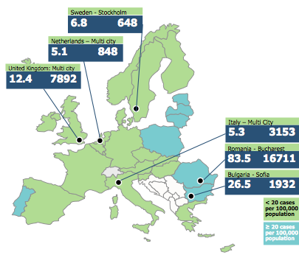
Partnerships: Countries
University College London (UCL) | UK
KNCV Tuberculosis Foundation (KNCV) | Netherlands
Ospedale San Raffaele (OSR) | Italy
National de Pneumoftiziologie Prof. Dr. Marius Nasta-National TB Programme (NTPR) | Romania
Karolinska Institute (KI) | Sweden
Universita degli Studi di Brescia (UNIBS) | Italy
Public Health England (PHE) | UK
Delft imaging systems (DELFT) | Netherlands
Folkhälsomyndigheten-Public Health Agency Sweden (FoHM) | Sweden
INMI Spallanzani, Rome (INMI) | Italy
Health Strategies Programme Centre-National TB Programme (HSPC) | Bulgaria
Other partners
ECDC
WHO Europe
IOM
Other EC funded projects: Hepcare

Slide 3
Objectives of E-DETECT TB project
To ensure early diagnosis in vulnerable populations - defined as homeless individuals, Roma, those with a history of drug use within the community, and prisoners - in two high incidence European countries (Romania and Bulgaria).
To strengthen care integration using an outreach strategy within the same vulnerable populations in Romania
To evaluate approaches for migrant TB detection and improve European cross-border management by:
  early detection and care integration in individuals arriving via the Mediterranean sea in Italy using innovative molecular testing at immigration reception centres and novel latent TB tests.
  collating, analysing and evaluating multi country data on TB in migrants to low incidence countries to inform effective strategies.
  ensuring cross-border transfer of information and referral of patients
  To support the development of action plans in member states by adapting best practice approaches.

Slide 4
Work Packages
WP 4 Outreach: Community and Prisons Screening
WP 6 Migrants: Learning from database integration
WP 5 Migrants: Screening in Italy
Coordination : WP 1
Dissemination : WP 2
WP 7: Strengthening national programmes
Evaluation : WP 3

Slide 5
Budget
CONSORTIUM | Total eligible costs | Maximum grant amount | % of total eligible costs funded by the EU
 | (I) | (II) | (III)
01-UCL | € 780,682.70 | € 571,535.00 | 73.21%
02-KNCV | € 180,523.98 | € 166,153.00 | 92.04%
03-OSR | € 376,918.20 | € 220,591.00 | 58.52%
04-NTPR | € 970,449.34 | € 358,380.00 | 36.93%
05-KI | € 242,890.00 | € 145,734.00 | 60.00%
06-UNIBS | € 116,351.80 | € 69,550.00 | 59.78%
07-DH PHE | € 95,991.84 | € 76,072.00 | 79.25%
08-DELFT | € 268,891.00 | € 167,666.00 | 62.35%
09-FoHM | € 10,700.00 | € 5,000.00 | 46.73%
10-INMI | € 120,696.00 | € 67,196.00 | 55.67%
11-HSPC | € 4,868.50 | € 4,868.00 | 99.99%
€ TOTAL / % AVERAGES | € 3,168,963.36 | € 1,852,745.00 | 58.47%

Slide 6
Objectives WP4
To ensure early diagnosis in vulnerable populations in Romania and Bulgaria, such as:
  Homeless individuals
  Roma population
  Injecting drug users
  Prisoners
To strengthen care integration using an outreach strategy within the same vulnerable populations in Romania by providing a one-stop “shop” approach.
This will be done by an outreach mobile digital x-ray screening unit equipped with automated x-ray reading equipment (CAD4TB) and rapid molecular diagnostics (GeneXpert).

Slide 7
Targets (output, outcome indicators)
2 years screening in Romania
Screen 80 persons per day, 4 days/week, 40 weeks/year (12,800 per year). In 2 years: 25,600.
Screening yield in year 1 (600/100,000) = 77 TB cases. Screening yield in year 2 (400/100,000) = 51 TB cases. Total: 126 cases found by screening.
We aime to start treatment in 100% of cases found by screening (50% within <1 week on treatment) and that >85% complete treatment.
(We assumed that 2% needs referrals, i.e. 250 per year (500 in 2 years)).

Slide 8
Activities
4.1: Equip mobile digital radiography unit (MXU)
4.2: Training of the staff to implement the screening activities: including a kick-off meeting in Romania and further training in London with the Find&Treat team
4.3: Screening of the vulnerable populations (project months 7-30).
4.4: Quality control with possible adaptation of the diagnostic methods and algorithm. This includes quality control procedures to assess the CAD4TB method through double reading by Romanian radiologists/chest physicians and Dutch experts and bacteriological quality control.

Slide 9
Activities
4.5: Strengthened care integration in vulnerable populations in Romania:
  Develop, agree and implement on the pathway and point of care for referred cases and treat TB patients in the screening programme under the conditions of the NTP Romania.
  In addition, peers will support the diagnosed patients to complete treatment successfully.
4.6: Implement a pilot screening in Sofia/Bulgaria:
  We will organise a kick-off meeting in Bulgaria to share screening practices in Romania, UK and the Netherlands.
  We will implement a pilot screening in high-risk settings in Sofia/Bulgaria for one week and evaluate it in WP3.

Slide 10
Activities
4.7: Project support:
  External consultants will support the service quarterly in the first operational year with on-site assistance and every half year in the second operational year.
  There will be an interim meeting with stakeholders and external consultants (including representatives of the Bulgarian NTP programme) will take place in Romania after 6-9 months of screening to discuss progress, achievements and challenges.
  A final meeting will take place after completing two years of screening, to discuss results, evaluate the screening and prepare the final report.

Slide 11
Roles and responsibilities in WP4
Marius Nasta Institute is responsible for the purchase of the van and the equipment.
The Romanian and Bulgarian partners are responsible for implementation of the screening.
KNCV and UCL are responsible for technical assistance in the training, screening and quality control. NTPR, KNCV and UCL are jointly responsible for the operational research, project evaluation and reporting.
A sustainability plan in Romania will be developed during the implementation phase, which will run beyond the end of the project.

Slide 12
Deliverables and milestones

Slide 13
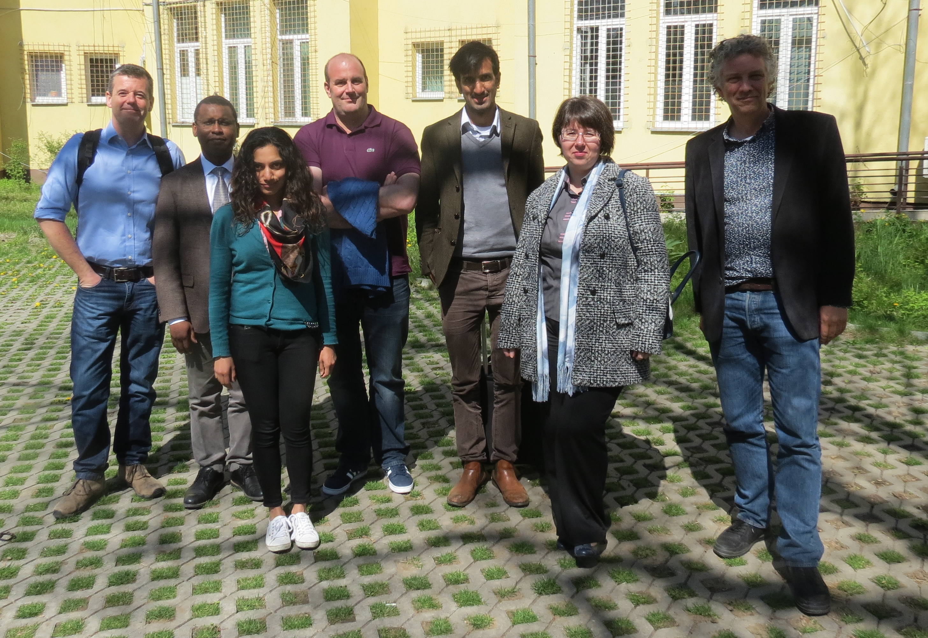
What have we done so far?
Technical assistance missions in Romania
  4-5 July 2016: Technical support visit (Al Story, Brendan Scott) to develop the tender for MXU
  2-3 November 2016: Discuss progress of the project, the groups for screening (Ibrahim Abubakar, Al Story, Gerard de Vries)
  10 April 2017: Discuss progress and CSO involvement (Ibrahim Abubakar, Al Story, Brendan Scott, Dee Menezes, Gerard de Vries), including visit on 11 April to IVECO (Al Story, Brendan Scott)
  4-6 May 2017: Discuss analysis TB in target groups in surveillance system, train pulmonologists on screening and CAD4TB (Gerard de Vries, Rob van Hest)

Slide 14
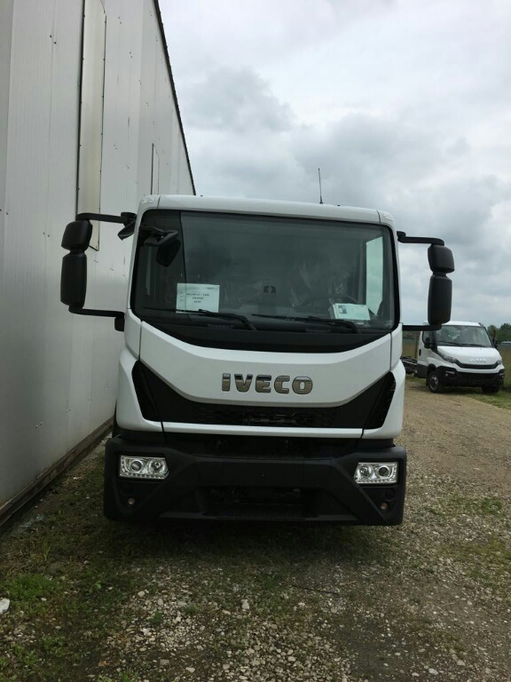
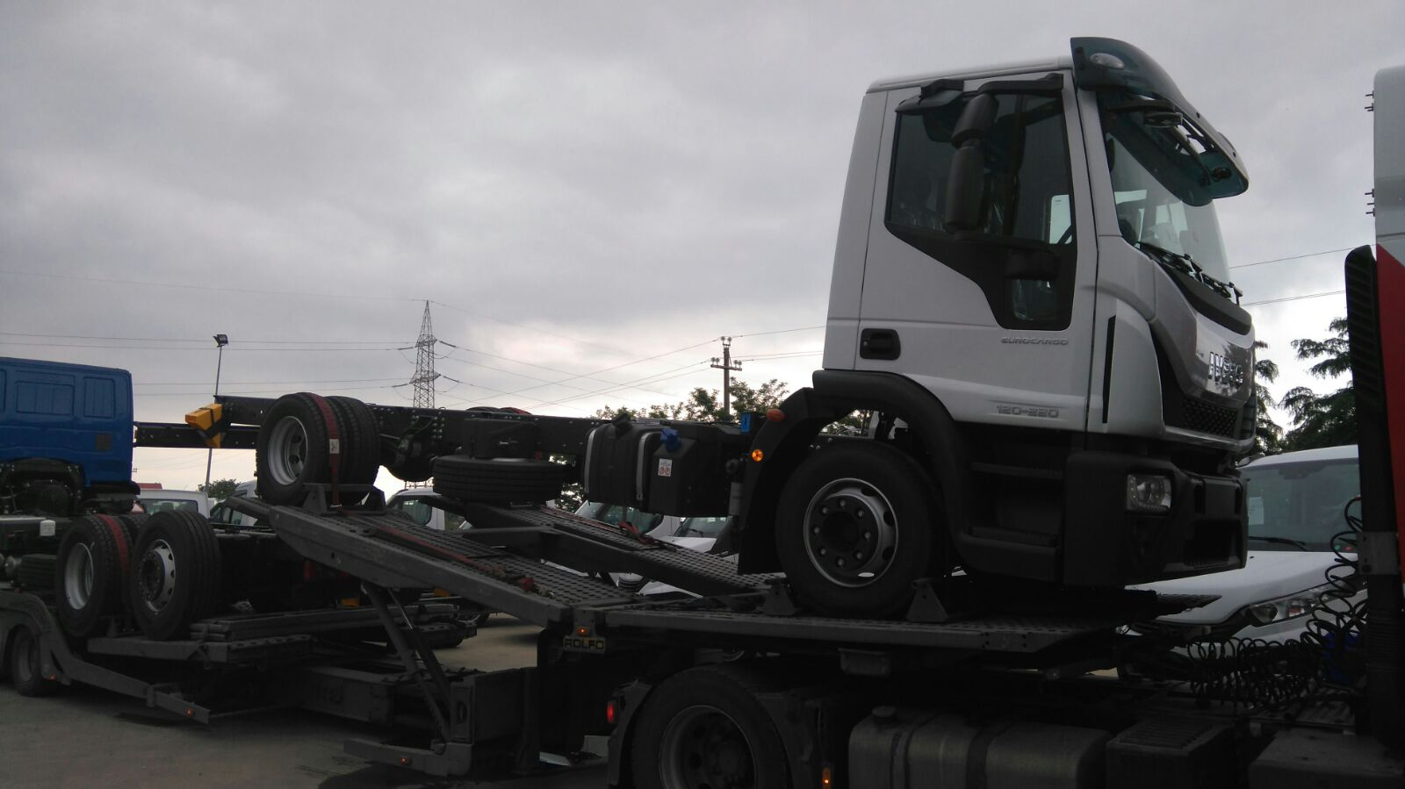
4.1 Mobile Health Unit

Slide 15
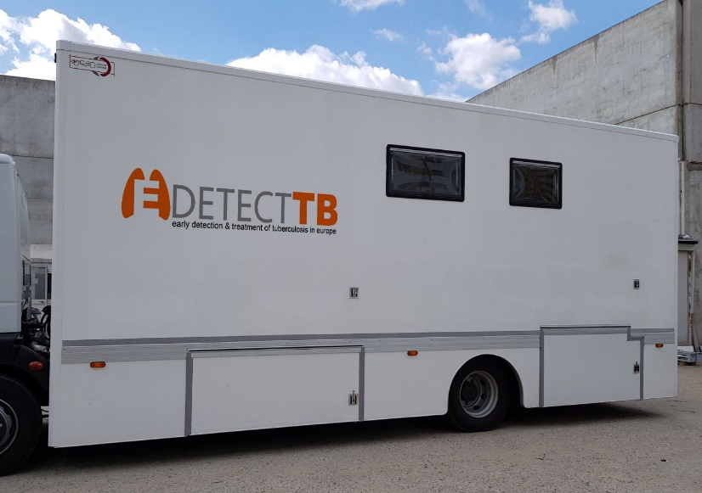
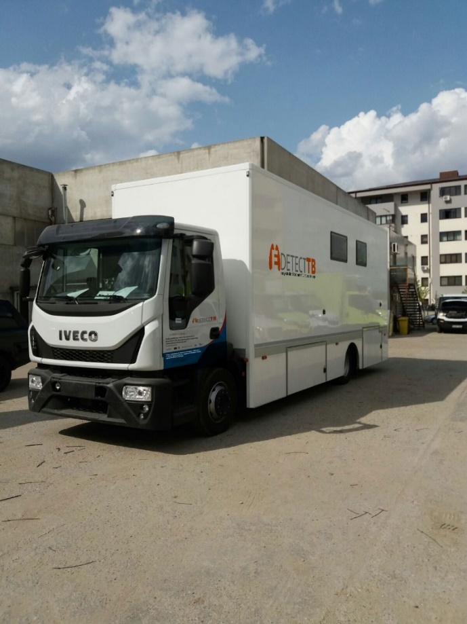
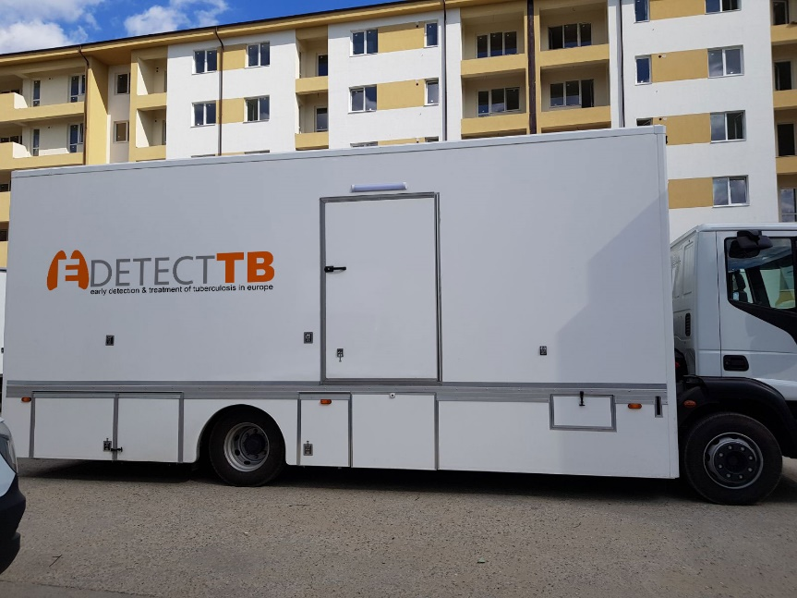
4.1 Mobile Health Unit

Slide 16
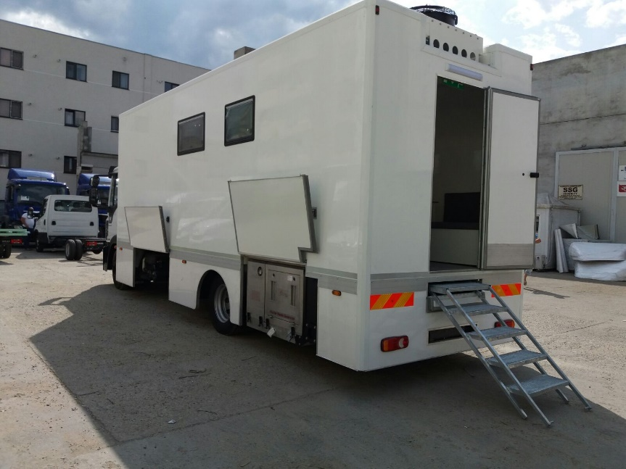
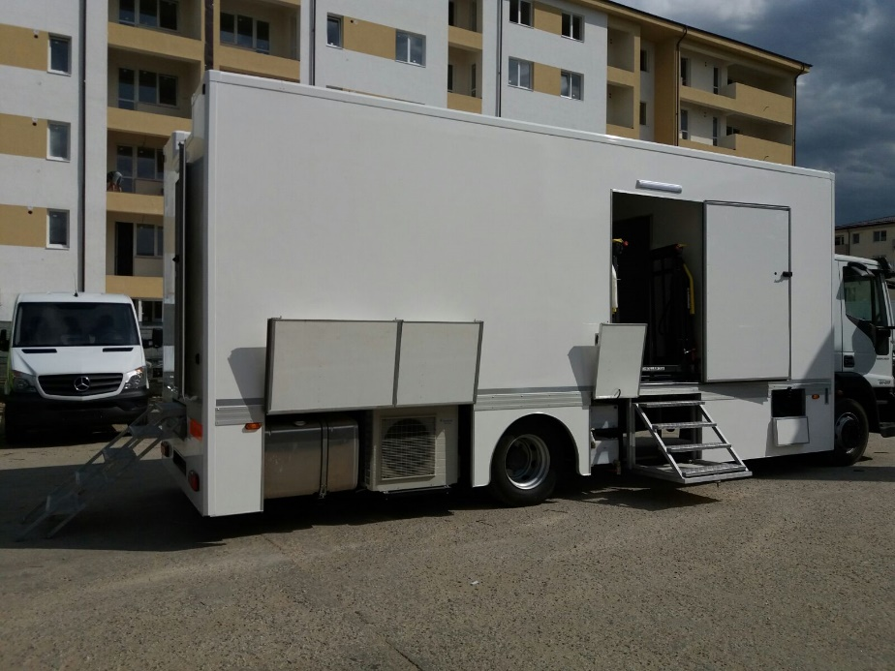
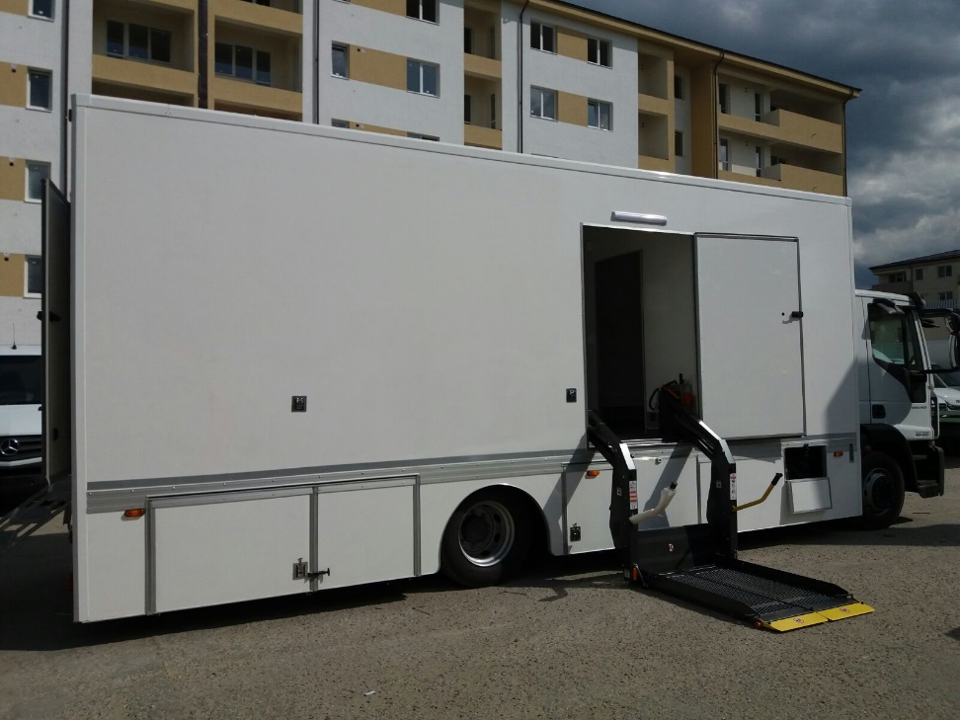
4.1 Mobile Health Unit

Slide 17
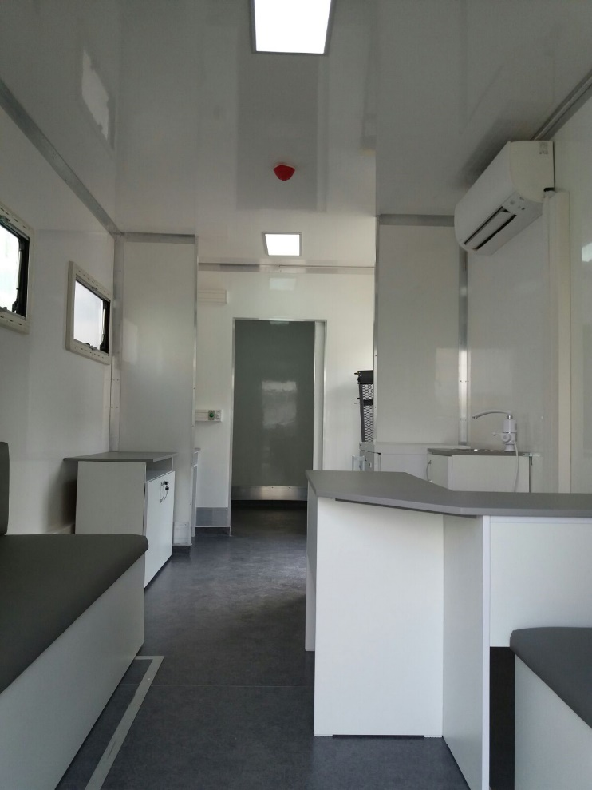
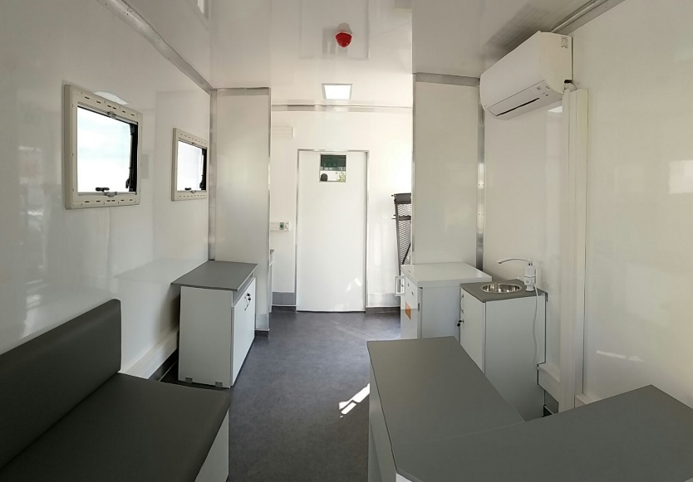
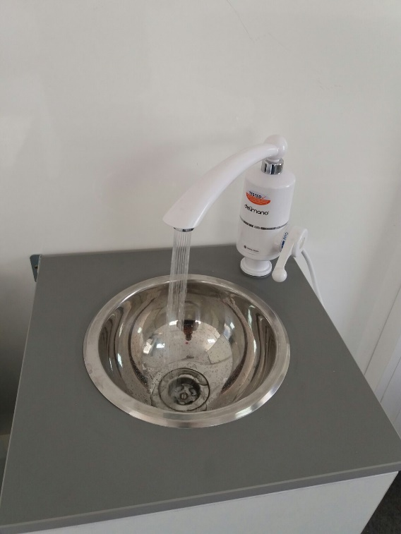
4.1 Mobile Health Unit

Slide 18
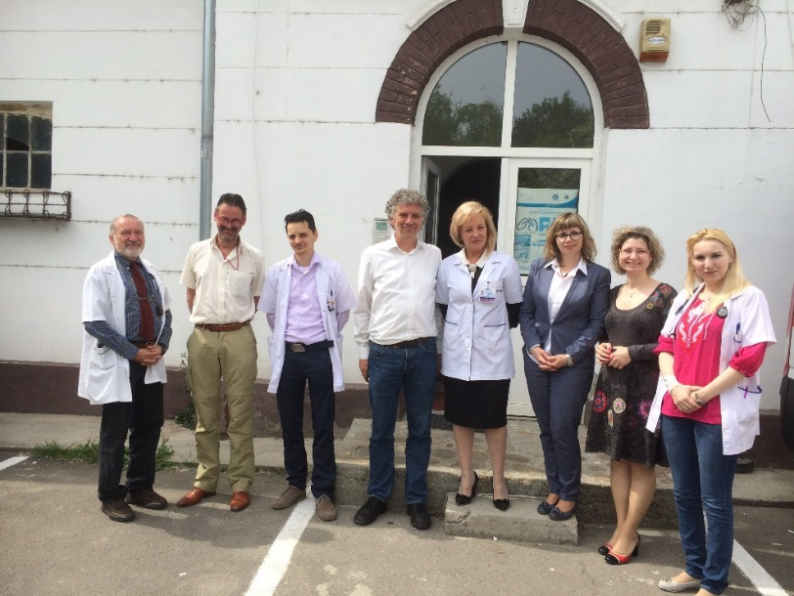
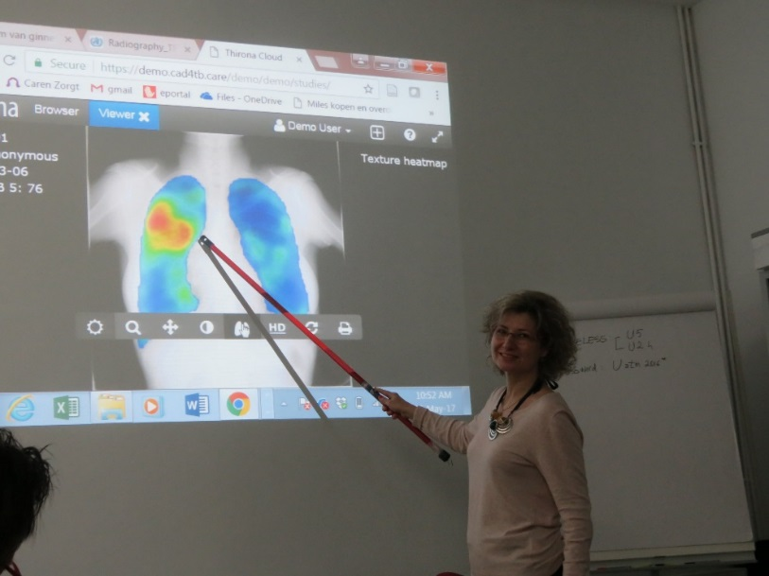
4.2 Training (Gerard de Vries)
Training pulmonologists on screening and CAD4TB (4-6 May 2017)
    https://edetecttb.cad4tb.care/edetecttb/demoset/series/
    https://demo.cad4tb.care/

Slide 19
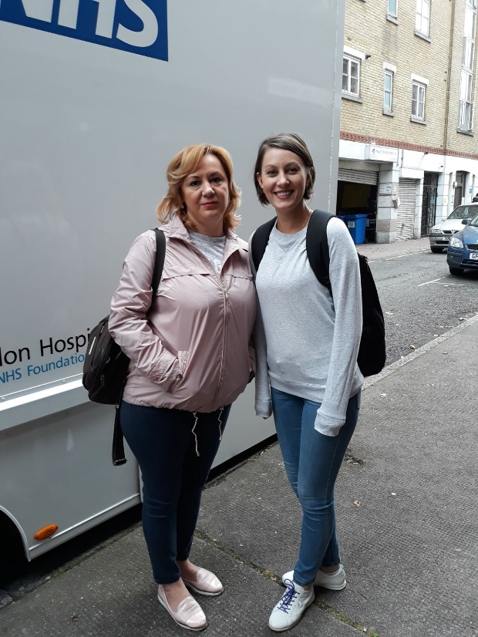
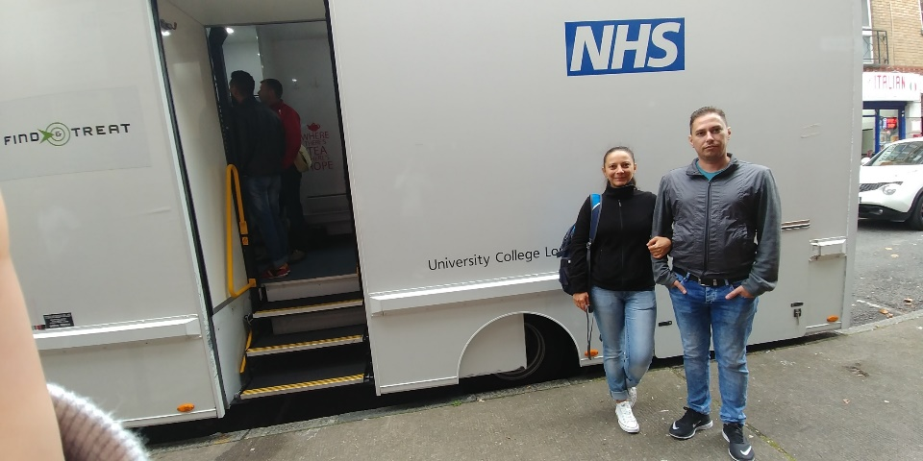
4.2 Training (Gerard de Vries)
2. Field visit and training with Find&Treat team in London (28th August – 2nd September 2017)
https://e-detecttb.eu/2017/10/17/romanian-team-visits-londons-findtreat/
www.marius-nasta.ro sectiunea proiecte / E-DETECT TB
3. (Kick-off meeting May/June 2018)

Slide 20
4.3 Selection screening sites
We discussed baseline data describing the current situation (characteristics of TB in risk groups, incidence and trends) and intention to submit it as a scientific paper.
We agreed to screen the first 3 months in prisons only.
The National Prison Authority has signed an agreement (to allow access in all penitentiaries in Romania, in the project we have only the southern part of the country included).

Slide 21
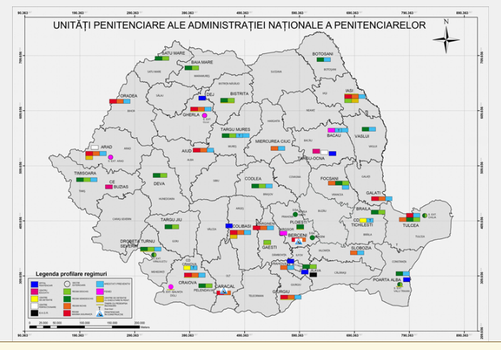
4.3 Selection screening sites
- 41 county prisons
- 2 in Bucuresti (Jilava, Rahova)
Prison information:
anp.gov.ro
(Astăzi 14/03/2018 sunt:
22960 persoane private de libertate)

Slide 23
4.3 Selection screening sites
4. Screening IDUs and homeless persons will start late 2018 and will be more challenging!
5. Ethics: we will ask clients for permission to use data for programmatic evaluation and studies (the consent will be documented in the IT-system).

Slide 24
4.4 Quality control (Gerard de Vries)
Patients with abnormal CAD4TB score will be requested to produce sputum for GeneXpert and for liquid culture (MGIT/LJ) allowing us to evaluate this algorithm.
DELFT will do a verification procedure to set the threshold.
Romanian pulmonologists will evaluate all CAD4TB abnormal CXRs and decide on the diagnostic pathway (=individual case management).
Dutch TB experts will read both CAD4TB normal and abnormal CXRs (blinded and anonymous) to assess the validity/accuracy of CAD4TB in identifying ‘presumptive TB cases’ in specific risk groups.

Slide 25
4.5 Strengthened care integration (Al Story)
Involvement CSOs (ARAS, Carusel Assocation) and peers – Success will depend on Partnership working across traditional professional / geographical and administrative boundaries

Slide 26
Challenges
We experienced long delay due to change in national procurement legislation, and a longer than expected tender process for the mobile health unit which took >½ year.
Difficulties to organise transfer of goods between partners, i.e. X-ray equipment from DELFT to Marius Nasta (transfer ownership, govt tax).
Time lines (Gantt chart) are much depending on building the truck and equipping it with X-ray equipment, IT, GeneXpert, etc.
IT software for screening and client management was not budgeted. It will be developed in Microsoft Access® by UCL (Dee).

Slide 27
Achievements
The Mobile X-ray Unit is build and equipped for screening (X-ray, Genexpert);
Training pulmonologist on screening and CAD4TB (4-6 May 2017);
Field visit to Find&Treat team in London (28 August – 2 September 2017);
Partnership agreements signed with institutions and NGOs to facilitate access to the targeted vulnerable groups: National Administration for Penitentiaries for prisoners, ARAS for IDUs, CARUSEL for Rroma population.

